Slide 1

DATA ANALYTICS
AIMAN ALAM
24.10.2023

Slide 2
Supervised learning
Supervised learning is a machine learning approach that’s defined by its use of labeled datasets. These datasets are designed to train or “supervise” algorithms into classifying data or predicting outcomes accurately. Using labeled inputs and outputs, the model can measure its accuracy and learn over time.
Supervised learning can be separated into two types of problems when data mining: classification and regression:
Classification problems use an algorithm to accurately assign test data into specific categories, such as separating apples from oranges. Or, in the real world, supervised learning algorithms can be used to classify spam in a separate folder from your inbox. Linear classifiers, support vector machines, decision trees and random forest are all common types of classification algorithms.
Regression is another type of supervised learning method that uses an algorithm to understand the relationship between dependent and independent variables. Regression models are helpful for predicting numerical values based on different data points, such as sales revenue projections for a given business. Some popular regression algorithms are linear regression, logistic regression and polynomial regression.

Slide 3
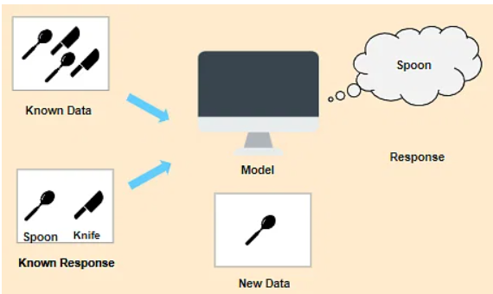
we have images that are labeled a spoon or a knife. This known data is fed to the machine, which analyzes and learns the association of these images based on its features such as shape, size, sharpness, etc. Now when a new image is fed to the machine without any label, the machine is able to predict accurately that it is a spoon with the help of the past data.

Slide 4
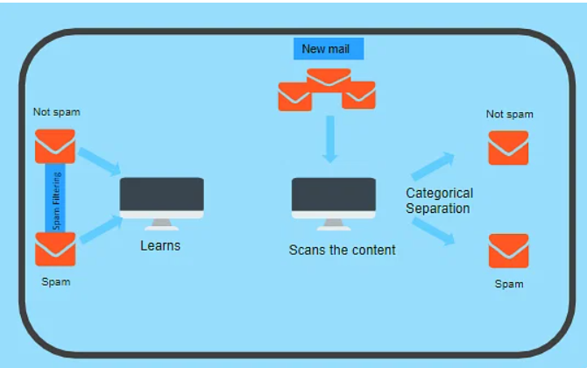
Classification - Supervised Learning
In order to predict whether a mail is spam or not, we need to first teach the machine what a spam mail is. This is done based on a lot of spam filters - reviewing the content of the mail, reviewing the mail header, and then searching if it contains any false information. Certain keywords and blacklist filters that blackmails are used from already blacklisted spammers.
All of these features are used to score the mail and give it a spam score. The lower the total spam score of the email, the more likely that it is not a scam.

Slide 5
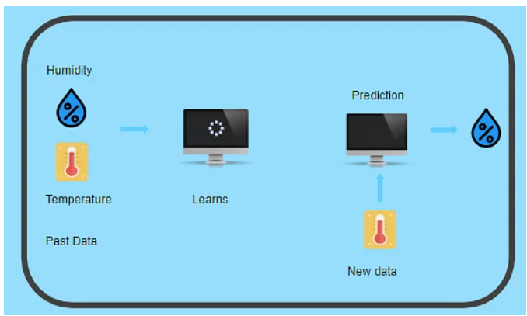
Regression - Supervised Learning
Let’s consider two variables - humidity and temperature. Here, ‘temperature’ is the independent variable and ‘humidity' is the dependent variable. If the temperature increases, then the humidity decreases.

Slide 6
Unsupervised learning
Unsupervised learning uses machine learning algorithms to analyze and cluster unlabeled data sets. These algorithms discover hidden patterns in data without the need for human intervention (hence, they are “unsupervised”).
Unsupervised learning models are used for three main tasks: clustering, association and dimensionality reduction:
Clustering is a data mining technique for grouping unlabeled data based on their similarities or differences. For example, K-means clustering algorithms assign similar data points into groups, where the K value represents the size of the grouping and granularity. This technique is helpful for market segmentation, image compression, etc.
Association is another type of unsupervised learning method that uses different rules to find relationships between variables in a given dataset. These methods are frequently used for market basket analysis and recommendation engines, along the lines of “Customers Who Bought This Item Also Bought” recommendations.
Dimensionality reduction is a learning technique used when the number of features (or dimensions) in a given dataset is too high. It reduces the number of data inputs to a manageable size while also preserving the data integrity. Often, this technique is used in the preprocessing data stage, such as when autoencoders remove noise from visual data to improve picture quality.

Slide 7
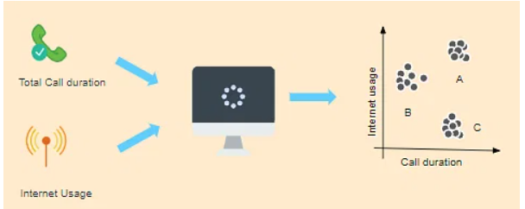
Clustering - Unsupervised Learning
On the right side of the image, you can see a graph where customers are grouped. Group A customers use more data and also have high call durations. Group B customers are heavy Internet users, while Group C customers have high call duration. So, Group B will be given more data benefit plans, while Group C will be given cheaper called call rate plans and group A will be given the benefit of both.
Suppose a telecom company wants to reduce its customer churn rate by providing personalized call and data plans. The behavior of the customers is studied and the model segments the customers with similar traits. Several strategies are adopted to minimize churn rate and maximize profit through suitable promotions and campaigns.

Slide 8
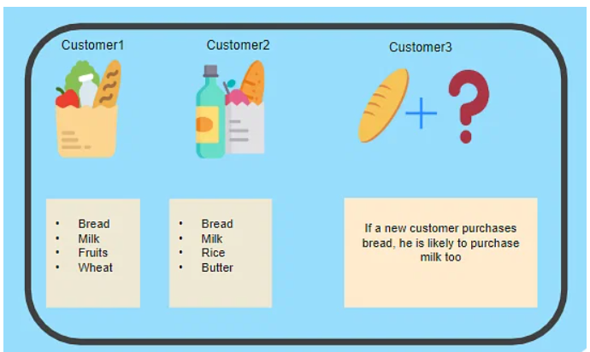
Association - Unsupervised Learning
Let’s say that a customer goes to a supermarket and buys bread, milk, fruits, and wheat. Another customer comes and buys bread, milk, rice, and butter. Now, when another customer comes, it is highly likely that if he buys bread, he will buy milk too. Hence, a relationship is established based on customer behavior and recommendations are made.
Association is a rule-based machine learning to discover the probability of the co-occurrence of items in a collection. For example, finding out which products were purchased together.

Slide 9
STANDARDIZATION
Imagine you have a recipe, but it's written in two different units of measurement. For example, one part of the recipe uses ounces, and another part uses grams. It can be confusing and challenging to follow the recipe because the units are not the same.
Standardization is like converting all the measurements to the same unit, making the recipe much easier to follow. In our example, you might choose to use either ounces or grams throughout the entire recipe, so everything is consistent.
In data, standardization does something similar. When you have different features (like height in inches, weight in pounds, and temperature in degrees), they might be in different units and scales. Standardization transforms all these features into a common scale, usually with a mean (average) of 0 and a standard deviation of 1. This makes it easier to work with the data, especially for machine learning algorithms, because they all "speak the same language."
In simpler terms, standardization is like making sure all the ingredients in your data recipe are measured in the same way so that you can cook up a successful analysis or model without any confusion.

Slide 10
STANDARDIZATION
A dataset is the heart of any ML model. It is of utmost importance that the data in a dataset are scaled and are within a particular range, to provide accurate results.
Standardization in machine learning , a type of feature scaling ,is used to bring uniformity to the datasets , resulting in independent variables and features of the same scale and range. Standardization transforms the standard deviation to 1 and the mean to 0 . In standardization, the mean is subtracted from each data point and the result obtained is divided by the standard deviation , resulting in standardized and rescaled data.
This technique is used in machine learning models such as Principal Component Analysis , Support Vector Machine and k-means clustering, as they depend on the Euclidean distance(shortest path between any two points).
The mathematical representation is as follows
Z = (X - m ) / s where
X − a data point
m − the mean
s − the standard deviation
Z − the standardized value

Slide 11
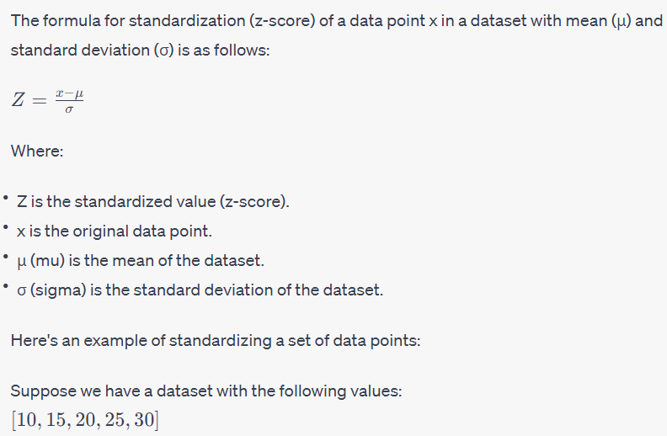

Slide 12
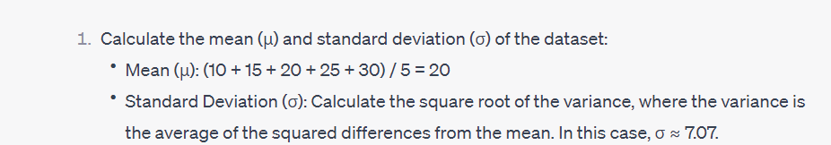
STEPS

Slide 13
Standard deviation
Standard deviation is a measure of how spread out or dispersed data points are in a dataset. It provides a way to understand the variability or the "typical" distance between individual data points and the mean (average) of the data.
Here's a simple way to think about standard deviation:
1. Small Standard Deviation: If the standard deviation is small, it means that most data points are close to the mean. In other words, the data is less spread out, and the values tend to cluster around the average.
2. Large Standard Deviation: If the standard deviation is large, it indicates that data points are more spread out from the mean. The values in the dataset can vary widely from the average.
In practical terms, standard deviation helps you answer questions like:
How much individual data points typically differ from the average?
How reliable or consistent is a set of data?
How much uncertainty or variability is present in a dataset?

Slide 14
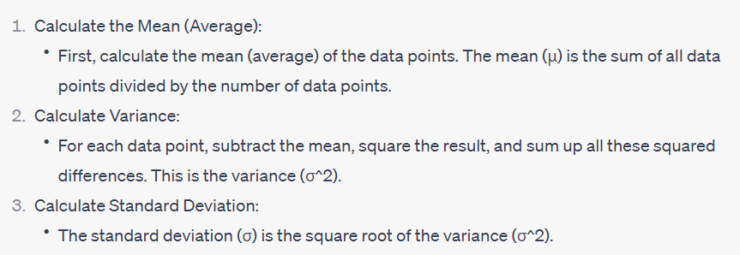
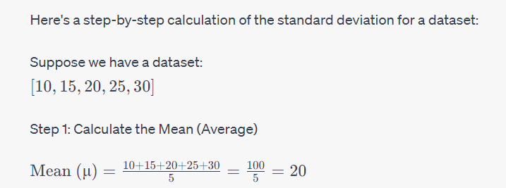
To calculate the standard deviation, we follow these steps

Slide 15
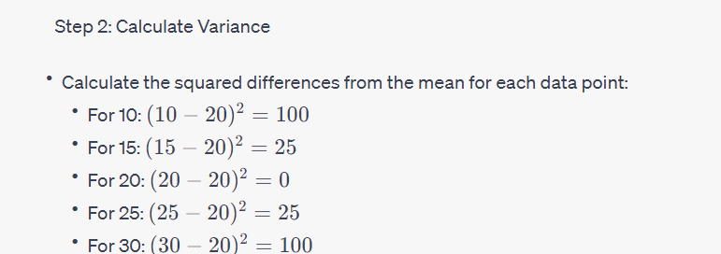
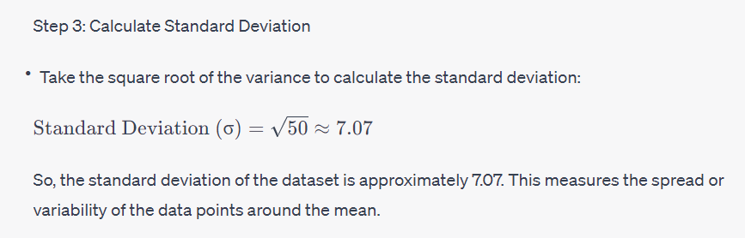
Calculate the variance by taking the average of these squared differences:
Variance = 100 + 25 + 0 + 25 + 100 / 5 = 50

Slide 16
Categorical encoding using Label-Encoding and One-Hot-Encoder
Label encoding is a way to convert categorical data, like words or labels, into numbers so that a computer can understand and work with them.
Encoding is a technique for preparing data for classification by converting categorical data into a numeric format.
Think of it like giving each category a unique number. For example, if you have a category "Red," you might assign it the number 1, and "Blue" could be 2. So instead of working with words, you're using numbers, which are easier for computers to process. This can be useful when you're working with machine learning algorithms, as many of them prefer numbers over words.
In many Machine-learning or Data Science activities, the data set might contain text or categorical values (basically non-numerical values). For example, color feature having values like red, orange, blue, white etc. Meal plan having values like breakfast, lunch, snacks, dinner, tea etc. Few algorithms such as CATBOAST, decision-trees can handle categorical values very well but most of the algorithms expect numerical values.

Slide 17
Over your learning curve in AI and Machine Learning, one thing you would notice that most of the algorithms work better with numerical inputs. Therefore, the main challenge faced by an analyst is to convert text/categorical data into numerical data and still make an algorithm/model to make sense out of it. Neural networks, which is a base of deep-learning, expects input values to be numerical values to achieve state-of-the-art results.
There are many ways to convert categorical values into numerical values. Each approach has its own trade-offs and impact on the feature set. Hereby, I would focus on 2 main methods: One-Hot-Encoding and Label-Encoder. Both of these encoders are part of SciKit-learn library (one of the most widely used Python library) and are used to convert text or categorical data into numerical data which the model expects and perform better with.

Slide 18
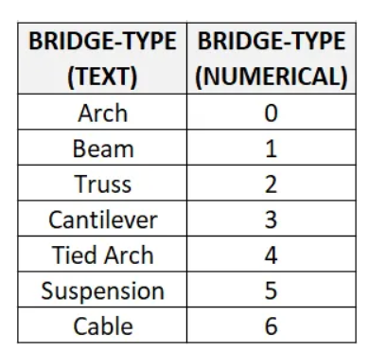
Label Encoding
This approach is very simple and it involves converting each value in a column to a number. Consider a dataset of bridges having a column name as bridge-types having these values. Though there will be many more columns in the dataset, to understand label-encoding, we will focus on one categorical column only.
BRIDGE-TYPE Arch Beam Truss Cantilever Tied Arch Suspension Cable

Slide 19
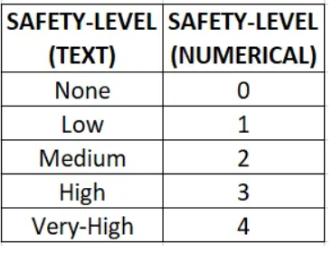

Slide 20
One-Hot Encoding
Imagine you have a list of different categories or types of something, like fruits. Let's say your list includes apples, bananas, and oranges.
Now, to use this information in a computer program or analysis, you need a way to represent each fruit. One way to do this is with a One-Hot Encoder. Here's how it works:
1. For each category (fruit in this example), you create a new column or attribute. So, you'd have a column for "apples," a column for "bananas," and a column for "oranges."
2. In these columns, you put a "1" if the item in your list belongs to that category and a "0" if it doesn't. For example, if you're talking about apples, you'd put a "1" in the "apples" column and "0" in the other columns for bananas and oranges.
It's like making a checklist for each category, and you mark with a "1" if something belongs to that category and "0" if it doesn't. This way, the computer can understand and work with the data more easily because it's in a format it can process.
One-Hot Encoding is commonly used in machine learning and data analysis when you have categorical data (like types of fruits, colors, or countries) and you want to use it in algorithms that work with numbers.

Slide 21
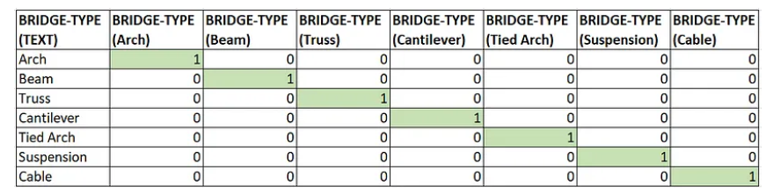
Though label encoding is straight but it has the disadvantage that the numeric values can be misinterpreted by algorithms as having some sort of hierarchy/order in them. This ordering issue is addressed in another common alternative approach called ‘One-Hot Encoding’. In this strategy, each category value is converted into a new column and assigned a 1 or 0 (notation for true/false) value to the column. Let’s consider the previous example of bridge type and safety levels with one-hot encoding

Slide 22
STUDENTS | APPLE | ORANGE | GRAPES | MANGO
HARRY | 1 | 0 | 0 | 0
DORESE | 0 | 0 | 1 | 0
LUKAS | 0 | 0 | 0 | 1
REENA | 1 | 0 | 0 | 0
DANNY | 0 | 1 | 0 | 0

Slide 23
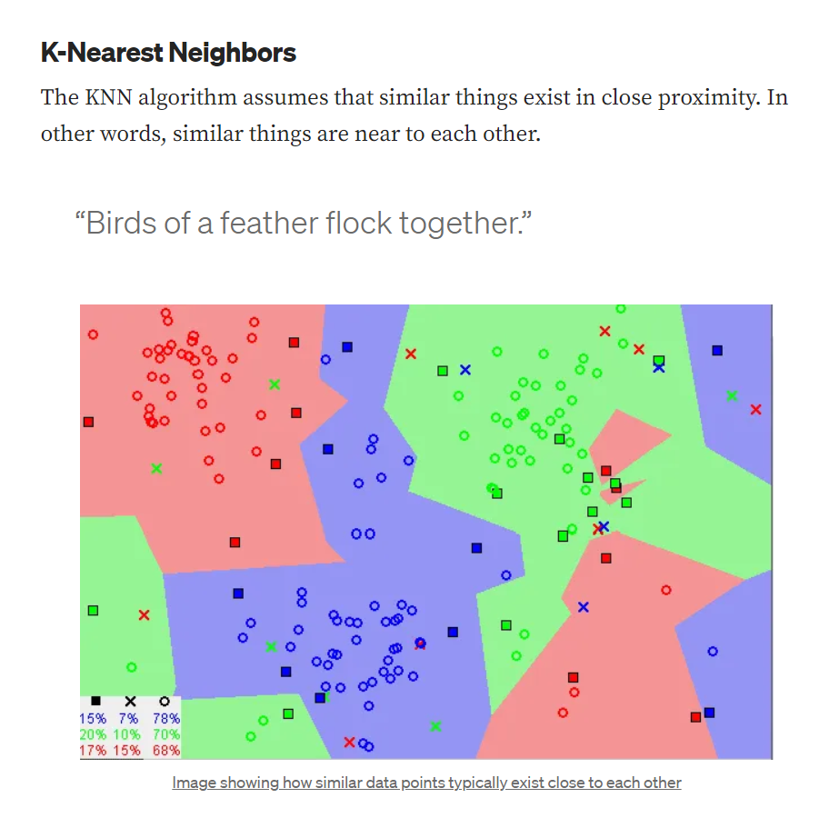

Slide 24
Choosing the right value for K
To select the K that’s right for your data, we run the KNN algorithm several times with different values of K and choose the K that reduces the number of errors we encounter while maintaining the algorithm’s ability to accurately make predictions when it’s given data it hasn’t seen before.
Here are some things to keep in mind:
As we decrease the value of K to 1, our predictions become less stable. Just think for a minute, imagine K=1 and we have a query point surrounded by several reds and one green (I’m thinking about the top left corner of the colored plot above), but the green is the single nearest neighbor. Reasonably, we would think the query point is most likely red, but because K=1, KNN incorrectly predicts that the query point is green.
Inversely, as we increase the value of K, our predictions become more stable due to majority voting / averaging, and thus, more likely to make more accurate predictions (up to a certain point). Eventually, we begin to witness an increasing number of errors. It is at this point we know we have pushed the value of K too far.
In cases where we are taking a majority vote (e.g. picking the mode in a classification problem) among labels, we usually make K an odd number to have a tiebreaker.

Slide 25
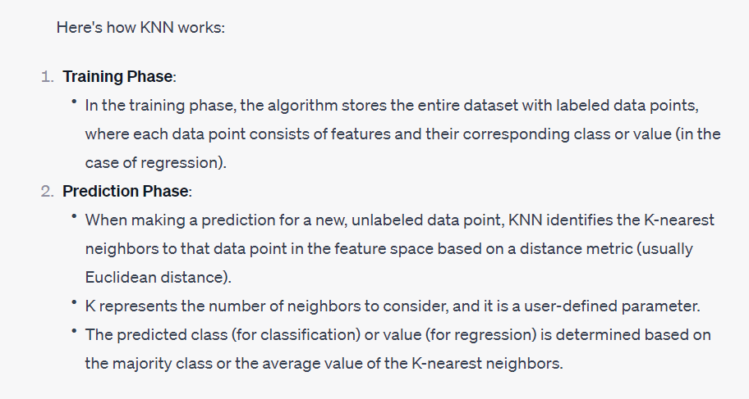

Slide 26
SVM
Support Vector Machine (SVM) classification is a supervised machine learning algorithm used for both binary and multiclass classification tasks. It is a powerful and versatile algorithm that seeks to find the optimal decision boundary or hyperplane that best separates data points from different classes in a high-dimensional feature space.
What is Support Vector Machine?
The objective of the support vector machine algorithm is to find a hyperplane in an N-dimensional space(N — the number of features) that distinctly classifies the data points.

Slide 27
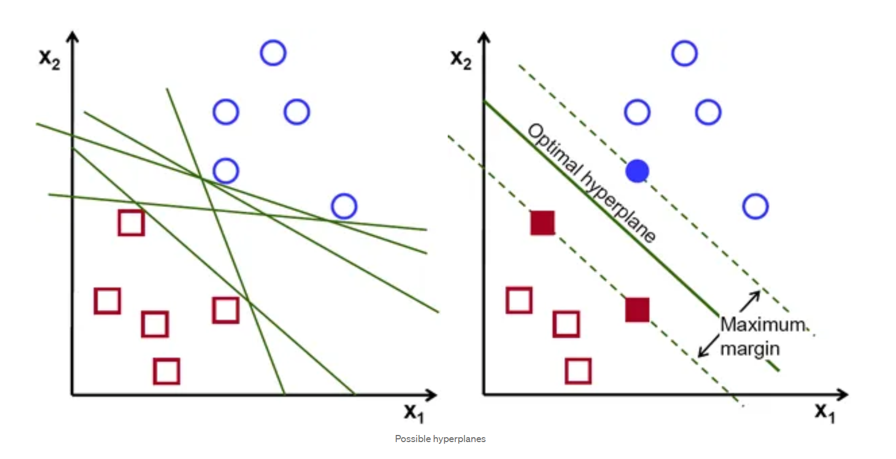
To separate the two classes of data points, there are many possible hyperplanes that could be chosen. Our objective is to find a plane that has the maximum margin, i.e the maximum distance between data points of both classes. Maximizing the margin distance provides some reinforcement so that future data points can be classified with more confidence.

Slide 28
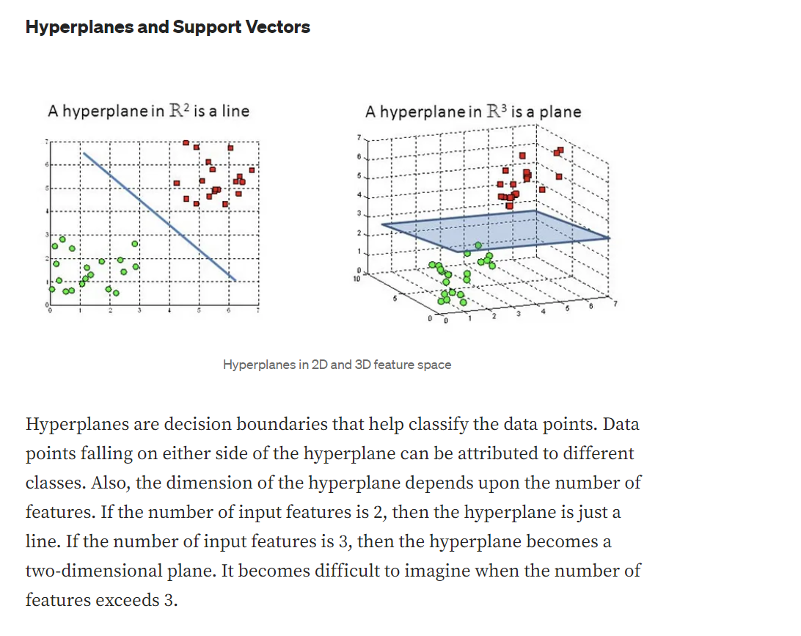

Slide 29
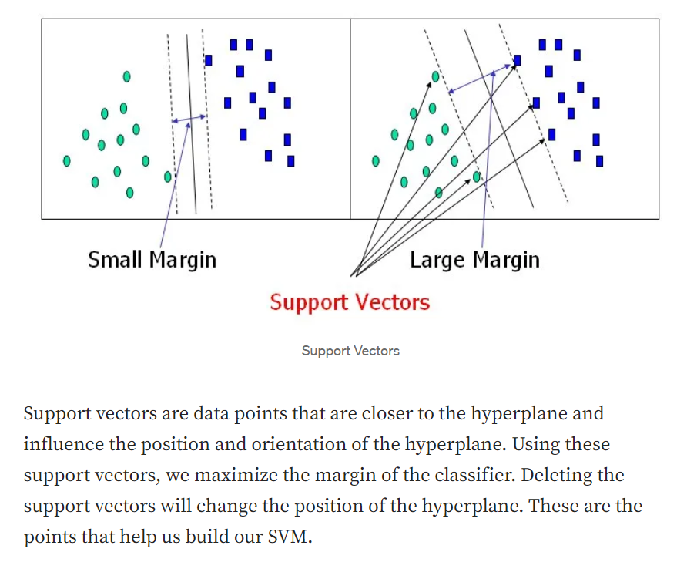

Slide 30
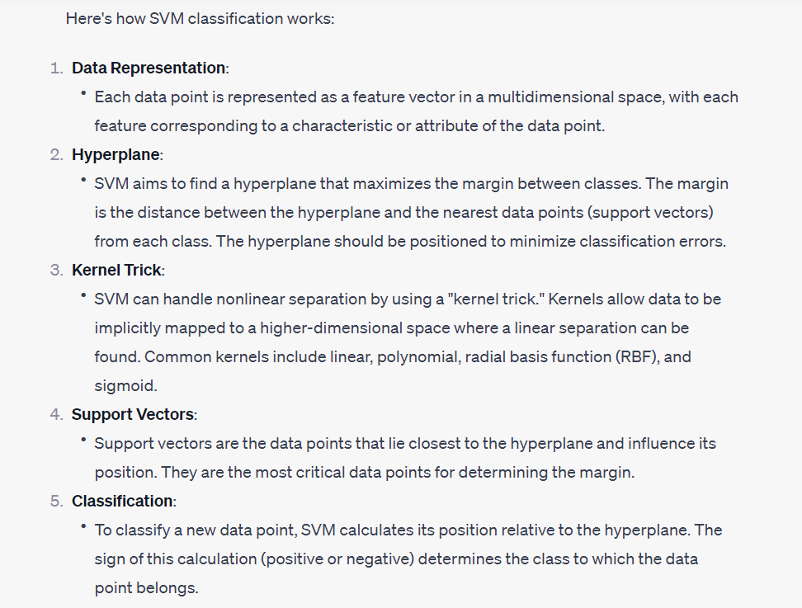

Slide 31
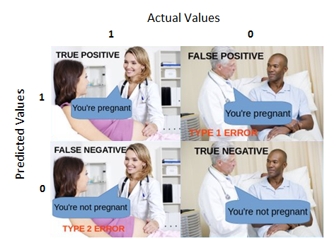
What is a confusion matrix?
A Confusion matrix is an N x N matrix used for evaluating the performance of a classification model, where N is the number of target classes. The matrix compares the actual target values with those predicted by the machine learning model.

Slide 32
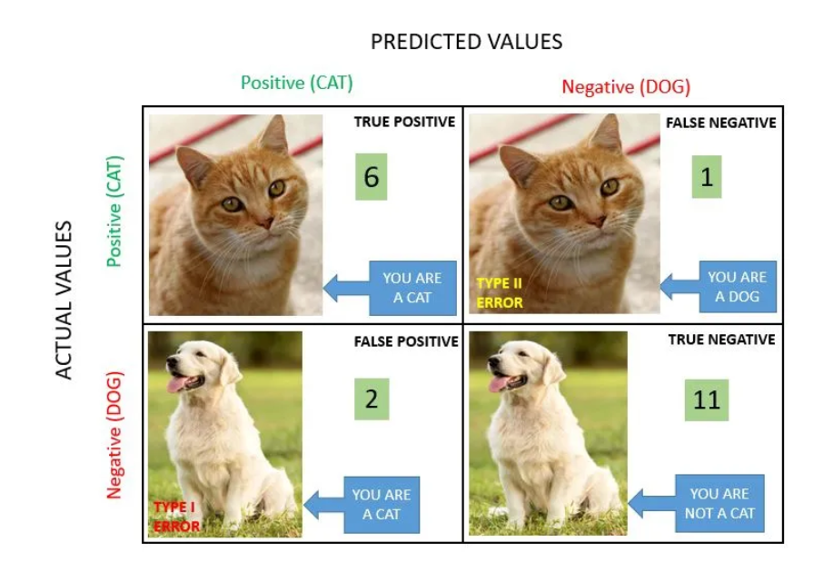

Slide 33
